Slide 1
Working with global climate data
Spatial Data Studio
Rachid Berghout

Slide 2
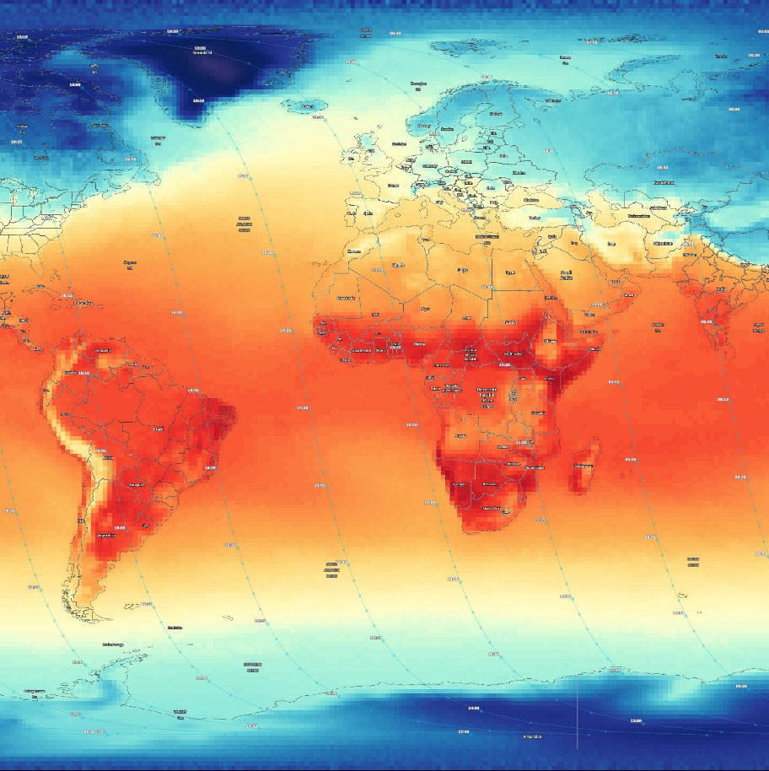
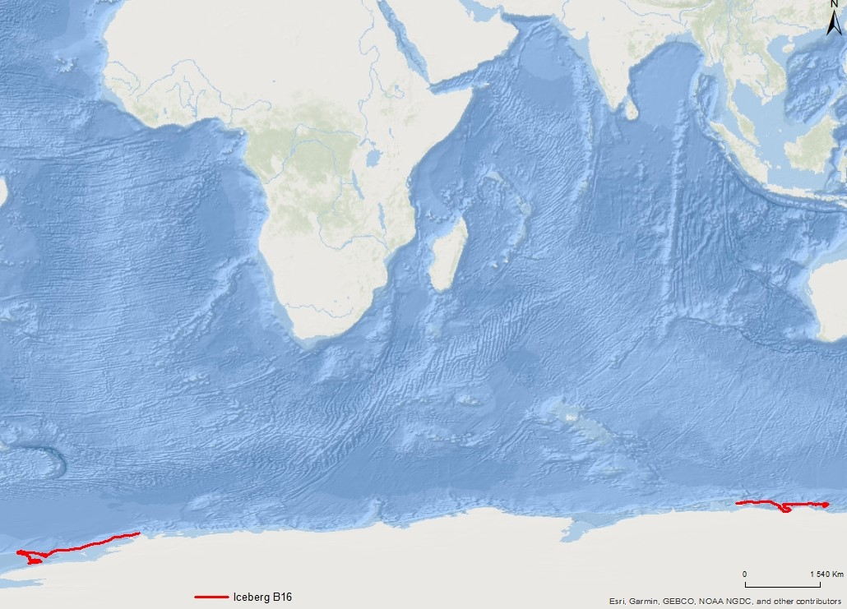
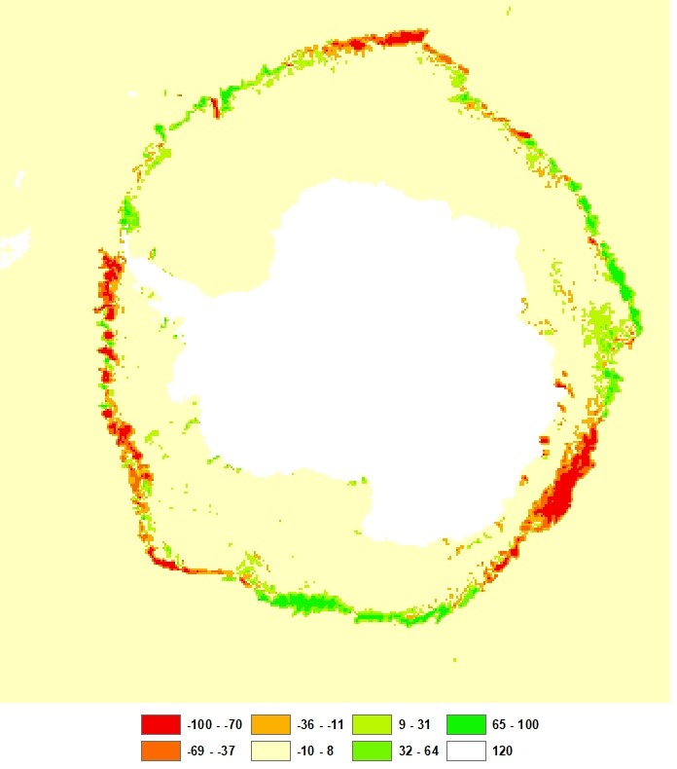
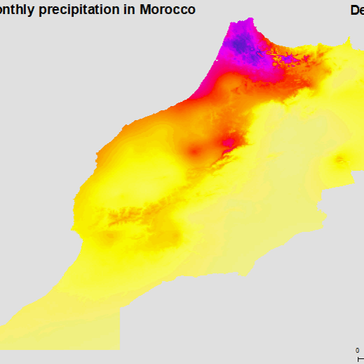
Outline
Assignment 1
Assignment 2
Assignment 3
Assignment 4
Surface Air Temperature (Day, monthly) variation in January and August 2018.
Movement of the Iceberg B16.
Sea ice concentration in Antarctica.
Average monthly Precipitation in Morocco.

Slide 3
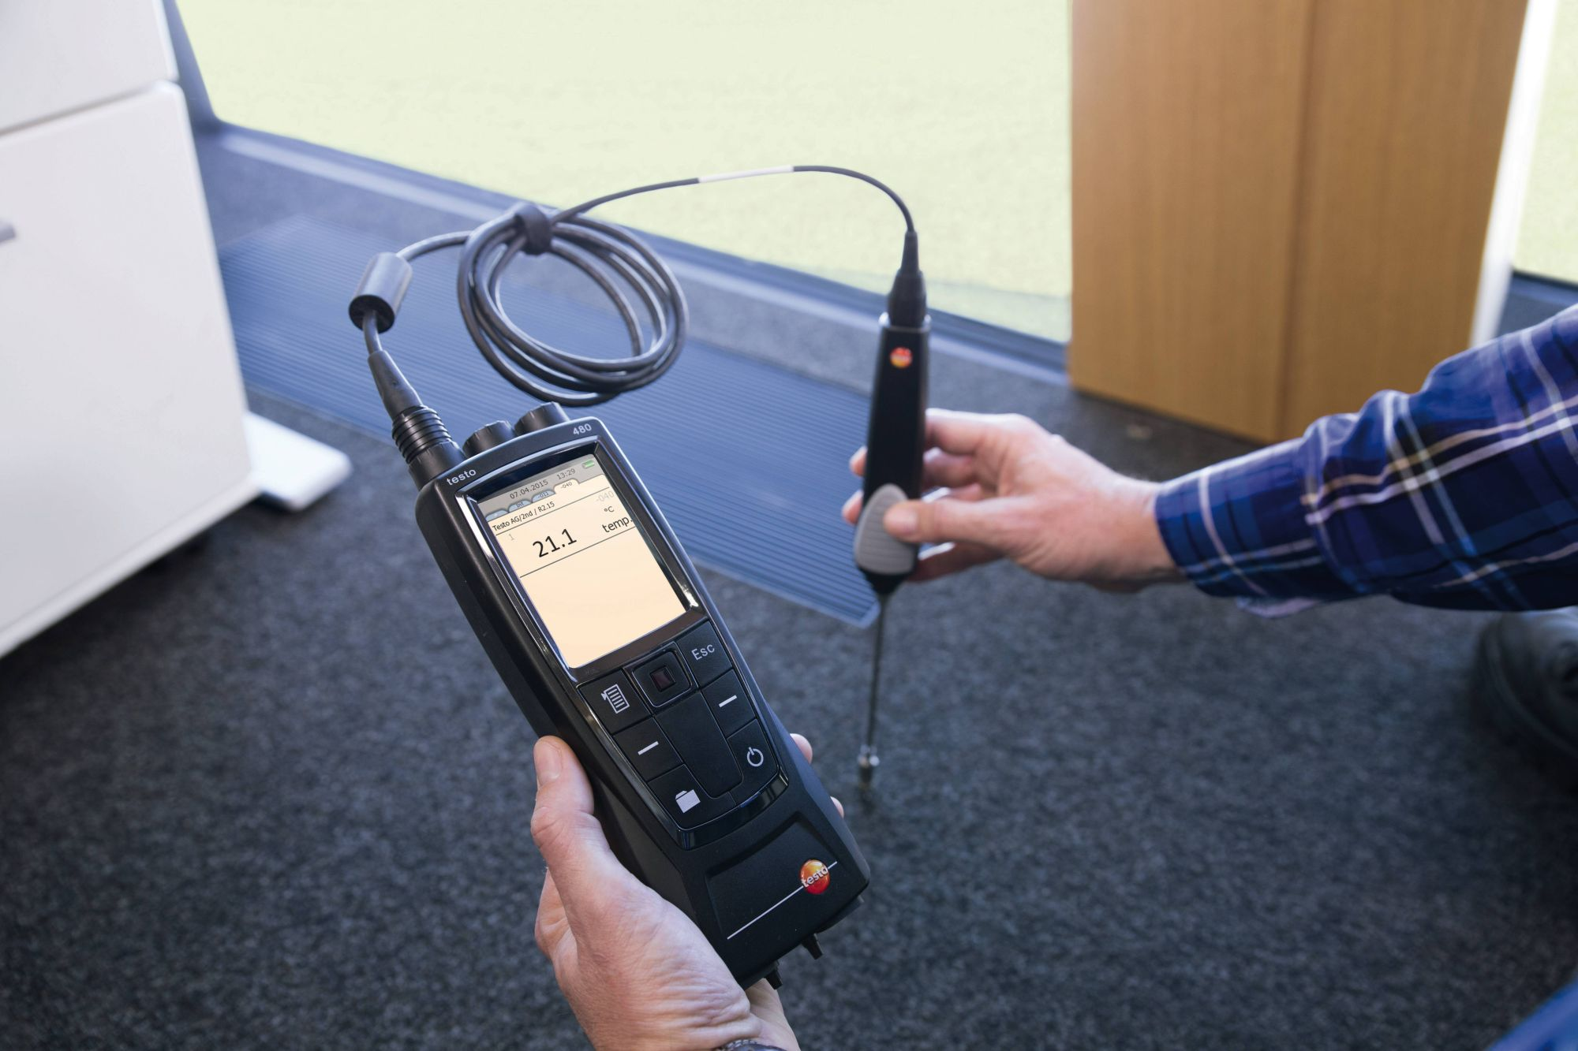
Assignment 1
The temperature of the air near the surface of the Earth, usually determined by a thermometer in an instrument shelter about 2 m above the ground (from Glossary 2016, by NASA).
Surface Air Temperature
www.testo.com
Notes:
testo 480 - Climate Measurement Tool
The true daily mean, obtained from a thermograph, is approximated by the mean of 24 hourly readings and may differ by 1.0 degrees C from the average based on minimum and maximum readings. The global average surface air temperature is 15 degrees C.

Slide 4

15 January 2018
< 200.0 k >= 320.0 k
https://worldview.earthdata.nasa.gov/
Notes:
200 k = -73,15 C
320 k = 46,85 C

Slide 5
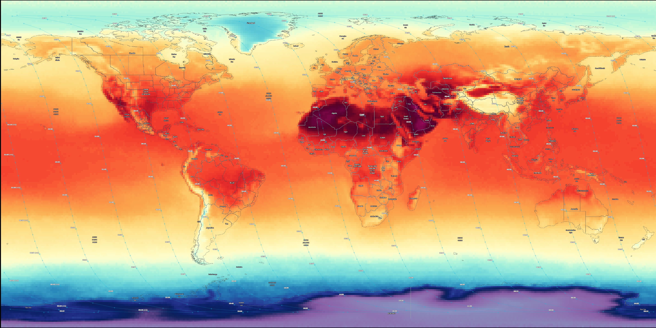
15 August 2018
< 200.0 k >= 320.0 k
https://worldview.earthdata.nasa.gov/
Notes:
200 k = -73,15 C
320 k = 46,85 C

Slide 6
Assignment 2
Movement of the Iceberg B16 from 30.08.2011 to 21.09.2018
2580 days (7 years and 23 days)
1772,5 Km
2927,2 Km
2015
2013

Slide 7
Assignment 3
Sea ice concentration change in Antarctica from 06.10.2018 to 15.10.2018

Slide 8
Assignment 4
significant spatial and temporal variation of precipitation.
The northwest is on average, more watered than the rest of the country.
Temparate climate in the coastal areas to the west.
Desert climate in the south and east of the country.
Average monthly precipitation in Morocco

Slide 9
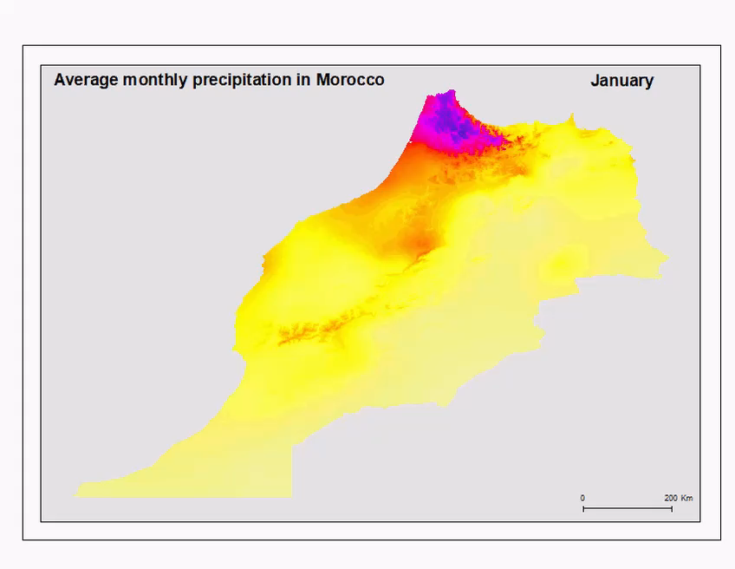

Slide 10
References
https://climate.copernicus.eu/surface-air-temperature-january-2018
https://climate.copernicus.eu/surface-air-temperature-august-2018
http://www.screentex-int.com/who-we-are/derbigum/etude_de_la_pluviometrie_au.pdf
https://www.testo.com/fr-BE/testo-480/p/0563-4800
http://nsidc.org/arcticseaicenews/2018/

Slide 11
Thank You!

